Slide 1

Advanced Programming
(C Programming language)
Chapter5– Functions

Slide 2
Basics of Functions
Basic concept
function declarations(函数定义）;formal parameters（形式参数）;the value of the function returns（函数返回值）；the result-type of the function（函数类型）;function call(函数的调用)；actual parameters(实在参数)；parameter passing(参数的传递)；……

Slide 3
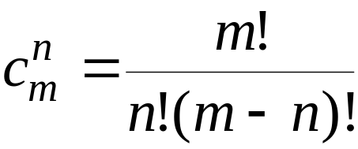
Foreward
[ex. 1] Compute the Combination
fact=1;
for(i=2;i<=n;i++)
fact*=i;
c=c/fact;
fact=1;
for(i=2;i<=m-n;i++)
fact*=i;
c=c/fact;
printf("c=%d\n",c);
}
main()
{ int m,n,i;
long fact,c;
scanf("%d%d",&m,&n);
fact=1;
for(i=2;i<=m;i++)
fact*=i;
c=fact;

Slide 4
Design a function
/* define a function fact */
long fact(int k)
{ int i;
long y=1;
for(i=1;i<=k;i++)
y*=i;
return(y);
}
/*fact is called by main()*/
main()
{ int m,n;
long c;
scanf("%d%d",&m,&n);
c=fact(m); /*calling fact*/
c=c/fact(n);
c=c/fact(m-n);
printf("c=%d\n",c);
}
actual parameters（实参） m,n,m-n
formal parameter（形参）k
c=fact(m)/(fact(n)*fact(m-n));

Slide 5
A program is just a set of definitions of variables and functions.
program
a
b
c
d
e
f
g
h
f
e
f
g

Slide 6
Functions
We have written programs with just one function - main
Program with only one function is difficult to maintain
has to dig up thousands lines of code to locate an error
some tasks may be repeated e.g. scientific calculation steps, output report elements such as report header etc.
Need to write program units (functions) other than main

Slide 7
Foundation of Functions
DECLARATIONS OF FUNCTIONS
/*function fact */
long fact(int k)
{
int i;
long y=1;
for(i=1;i<=k;i++)
y*=i;
return(y);
}
Five factors of functions
Function name
Declaration of arguments(
name and type of arguments)
Type of function value
Function
Returning value of function

Slide 8
Each function defintion has the form
result-type function-name(argument specifiers)
{
declarations and statements
}
Various parts may be absent; a minimal function is
dummy() {}

Slide 9
Sorts of Functions
by use
library functions（库函数）
functions defined by user( 用户自定义函数)
by format
functions take arguments or don’t take arguments(有参函数、无参函数)
null functions(空函数)
functions return result or don’t return result(有返回值、无返回值)

Slide 10
Function Call
void main (void)
{
function1 ( );
}
void function1 (void)
{
printf ("function1 is a void function that does not receive\n\
\rvalues from main.\n\n");
}
Output
transfers program control to the function
Control transfer from main to first line of function1

Slide 11
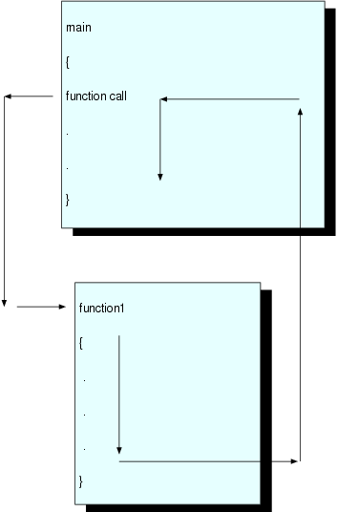
Multi-functions Program
Main call function1 and transfer control to that function
Execution will resume at point of function call after finishing execution
flow control has been transferred to and back between the two functions

Slide 12

Parameters in Function
void main (void)
{
int m;
double y;
m = 15;
y = 308.24;
printf ("The value of m in main is m=%d\n\n", m);
function2 (m, y);
printf ("The value of m in main is still m=%d\n", m);
}
void function2 (int n, double x)
{
printf ("function2 is a void function that does receive\n\
\rvalues from main. The values received from main are:\n\
\r\t n=%d \n\r\t x=%lf\n\n", n, x);
}
Output

Slide 13

Functions
Function call
  To call (or invoke) a function, write function name followed by arguments enclosed in parentheses
  f_name (exp, exp,. . .)
  E.g. function2(m,y);
  transfers program control to first statement of function
  control goes back to location at which the function was called upon finished executing the function
To pass any information from main to called function2
In function2, we created the variable names n and x through
void function2(int n, double x)

Slide 14
Functions
to define and make use of a programmer-defined function, three things are needed
  function prototype
  function definition
  function call
function prototype
  a declaration indicates that the function exists
one line of code that gives the function’s name, return type, and parameters (note semicolon at the end)
r_type f_name (arg_type arg_name, arg_type arg_name,. . . . .);
  establish the type of arguments a function is to receive and the order in which it is to receive them (for compiler use)

Slide 15
Function Prototype
void function1 (void); // prototype
void main (void)
{
function1 ( );
}
void function1 (void) // function definition
{
printf ("function1 is a void function that does not receive\n\
\rvalues from main.\n\n");
}
indicates that function1 returns no value because it is of type void
and it has no arguments

Slide 16
Functions
function definition
  body of a function
  r_type f_name (arg_type arg_name, arg_type arg_name,. . .)
  {
  function body
  C declaration and statements
  }
  First line called function header e.g.
  void function2(int n, double x)
It is not necessary to have main as the first function as long as we have function prototype defined at top

Slide 17
Give following functions’ type
void printline(void)
{ int i;
for(i=1;i<=30;i++)
printf("-");
printf("\n");
}
long fact(int k)
{ int i;
long y=1;
for(i=1;i<=k;i++)
y*=i;
return(y);
}
main()
{ int m,n;
long c;
printline();
printf("m,n=");
scanf("%d%d",&m,&n);
c=fact(m)/(fact(n)*fact(m-n));
printline();
printf("c=%d\n",c);
getch();
}

Slide 18
[ex. 2] Define a function to find the max one of two numbers
main()
{ int max(int n1, int n2)； /*declaration*/
int num1,num2；
printf("input two numbers:\n")；
scanf("%d%d", &num1, &num2)；
printf("max=%d\n", max( num1 , num2 ))；
getchar();
} parameter passing
int max( int n1 , int n2 ) /*define max()*/
{ return ( n1>n2?n1:n2 )；
}

Slide 19
[ex.3] output all of primes between 2 and 200
main()
{ int i, j, counter=0;
for(i=2 ; i<=200; i++)
{
if ( prime( i ) )
{ printf(“%8d”,i);
counter++;
}
}
printf(“\ncounter=“);
printf(“%d\n”,counter);
}
main()
{ int i, j, counter=0;
for(i=2 ; i<=200; i++)
{ for(j=2; j<=i-1; j++)
if(i%j==0)
break;
if( j == i )
{ printf(“%8d”,i);
counter++;
}
}
printf(“\ncounter=%d\n”,counter);
}

Slide 20
Design a function
int prime(int k)
{ int i, p;
for(i=2; i<=k-1; i++)
if( k%i==0)
break;
if( i==k )
p=1;
else
p=0;
return(p);
}
main()
{ int i, j, counter=0;
for(i=2 ; i<=200; i++)
{ if ( prime( i ) )
{ printf("%8d",i);
counter++;
}
}
printf("\ncounter=");
printf("%d\n",counter);
}
return(i==k);

Slide 21
Functions Returning Non-integers
Return statement form:
return ( expression );
return expression ;
return ;
The return statement is the mechanism for returning a value from the called function to its caller. Any expression can follow return:
return expression;
The expression will be converted to the return type of the function if necessary. Parentheses are often used around the expression, but they are optional.

Slide 22
函数的返回值是通过return语句带回到主调函数的
函数的返回值
return 语句格式：
return (表达式); 或 return 表达式 ;
或 return;
功能：终止函数的运行，返回主调函数，若有返回值，将返回值带回主调函数。
说明：
① 若函数没有返回值，return语句可以省略。
② return语句中的表达式类型一般应和函数的类型一致，如果不一致，系统自动将表达式类型转换为函数类型。

Slide 23
Functions Return Just One Value
#include <stdio.h>
unsigned long int fact (int m);
int main (void)
{
int n;
unsigned long int g;
double one_over_nfactorial;
scanf ("%d", &n);
g = fact (n);
one_over_nfactorial = 1. / g;
printf ("1/%d! = %e", n, one_over_nfactorial);
return (0);
}
unsigned long int fact(int m)
{ int i;
unsigned long int product;
product = 1;
for (i=m; i>=1; i--)
{
product *= i;
}
return (product);
}

Slide 24
Functions Return One Value
library functions that accept one value and return another
y=log(x);
User defined function fact to compute the factorial of an integer
function that returns a value must have a type that reflects the type of value returned
unsigned long int fact(int m);
In doing this, a return statement must appear in the body of the function
return (product);

Slide 25
Functions Return Just One Value
form of the return
return expression;
or
return (expression);
Where does the value of the variable product (in example) return?
  causes execution to transfer unconditionally to calling statement
  the value of product is passed to the location of the function call in statement
  g = fact(n);
return statement can appear anywhere in the function body
type int for main – typically returned 0 to the operating system, which interprets as the program has terminated normally.

Slide 26
【Ex.4】编一程序，将主函数中的两个变量的值传递给swap函数中的两个形参，交换两个形参的值。
void swap(int x, int y)
{ int z;
z=x; x=y; y=z;
printf("\nx=%d,y=%d",x ,y);
}
int main( )
{ int a= 10,b=20;
swap(a,b);
printf("\na=%d,b=%d\n",a,b);
return 0;
}
形式参数（形参）
单向值传递
实际参数（实参）
程序输出结果：
x=20,y=10
a=10,b=20

Slide 27
有关形参和实参的说明：
① 当函数被调用时才给形参分配内存单元。调用结束，所占内存被释放。
② 实参可以是常量、变量或表达式，但要求它们有确定的值。
③ 实参与形参类型要一致，字符型与整型可以兼容。
④ 实参与形参的个数必须相等。在函数调用时，实参的值赋给与之相对应的形参。“单向值传递”。

Slide 28
Storage Classes
Storage class specifiers
  Storage duration – how long an object exists in memory
  Scope – where object can be referenced in program
  Linkage – specifies the files in which an identifier is known
There are four storage classes in C:
  Automatic storage class
  Static storage class
  Register storage class
  External storage class

Slide 29
Automatic storage
  Object created and destroyed within its block
  auto: default for local variables
      auto double x, y;
  register: tries to put variable into high-speed registers
    Can only be used for automatic variables
      register int counter = 1;
ALU
Memory

Slide 30
Program
Static Variables
Dynamic Variables

Slide 31
Static storage
  Variables exist for entire program execution
  Default value of zero
  static: local variables defined in functions.
    Keep value after function ends
    Only known in their own function
  extern: default for global variables and functions
    Known in any function
ALU
Memory

Slide 32
Scope
File scope
  Identifier defined outside function, known in all functions
  Used for global variables, function definitions, function prototypes
Function scope
  Can only be referenced inside a function body
A variable declared within a function is unrelated to variables declared elsewhere, even if they have the same name.
A function cannot access variables that are declared in other functions.

Slide 33
Block scope
  Identifier declared inside a block
    Block scope begins at declaration, ends at right brace
  Used for variables, function parameters (local variables of function)
  Outer blocks "hidden" from inner blocks if there is a variable with the same name in the inner block
Function prototype scope
  Used for identifiers in parameter list

Slide 34
Wrong way to do it
int add_one(int b)
{
a = b + 1;
}
int main(void)
{
int a = 34, b = 1;
add_one(b);
printf("a = %d, b = %d\n", a, b);
return 0;
}
Compilation error!
a is in a different scope

Slide 35
Right way to do it
int add_one(int b)
{
b = b + 1;
return b;
}
int main(void)
{
int a = 34, b = 1;
a=add_one(b);
printf("a = %d, b = %d\n", a, b);
return 0;
}

Slide 36
{
int a = 2;
printf(“%d\n”,a);
{
int a = 5;
printf(“%d\n”,a);
}
printf(“%d\n”,++a);
}

Slide 37
{ int a=1,b=2,c=3;
printf(“%d%d%d\n”,a,b,c);
{ int b=4;
float c=5.0;
printf(“%d%d%f\n”,a,b,c);
a=b;
{ int c;
c=b;
printf(“%d%d%f\n”,a,b,c);
}
printf(“%d%d%f\n”,a,b,c);
}
printf(“%d%d%f\n”,a,b,c);
}

Slide 38
8.9 变量的存储类别－－8.9.5 用extern声明外部变量
文件file1.c中的内容为：
#include <stdio.h>
int A; /*定义外部变量*/
void main( )
{ int power(int); /*函数声明*/
int b=3,c,d,m;
printf(“enter the number a and its power m:\n”);
scanf(“%d,%d”, &A, &m);
c=A*b;
printf(“%d*%d\n”,A,b,c);
d=power(m);
printf(“%d**%d=%d\n”,A,m,d);
}
文件file2.c中的内容为：
extern A； /*声明A为一个已定义的外部变量*/
int powre(int n)
{ int i,y=1;
for ( i=1; i<=n; i++)
y=y*A;
return (y);
}
例8.21 用extern将外部变量的作用域扩展到其他文件。本程序的作用是给定b的值，输入a和m，求a×b和a^{m}的值。

Slide 39
main(){
int a=2,i;
clrscr();
for (i=0;i<3;i++)
printf("%4d",f(a));
}
f(int a){
int b=0;
static int c=3;
b++;c++;
return a+b+c;
}

Slide 40
int a=3,b=5;
●
max(int a,int b) {
int c;
c=a>b?a:b;
return c;
}
main(){
int a=8;
printf("%d\n",max(a,b));
}

Slide 41
int a;
fun(int i){
a+=2*i;
return a;
}
main(){
int a=10;
printf("%d,%d\n",fun(a),a);
}
●

Slide 42
Scope
int m = 12;
int function1 (int a, int b, int c, int d);
void main (void)
{
int n = 30;
int e, f, g, h, i;
e = 1;
f = 2;
g = 3;
h = 4;
printf ("\n\n In main (before the call to function1):\n\
\r m = %d\n\
\r n = %d\n\
\r e = %d\n\n", m, n, e);
i = function1 (e, f, g, h);
printf ("After returning to main:\n");
printf ("n = %d \n\
\r m = %d \n\
\r e = %d \n\
\r i = %d", n, m, e, i);
}

Slide 43
Scope
int function1 (int a, int b, int c, int d)
{
int n = 400;
printf ("In function1:\n\
\r n = %d\n\
\r m = %d initially\n\
\r a = %d initially \n",n,m,a);
m = 999;
if (a>=1) {
a += b + m + n;
printf ("m = %d after being modified\n\
\r a = %d after being modified\n\n", m, a);
return (a);
}
else {
c += d + m + n;
return (c);
}
}

Slide 44
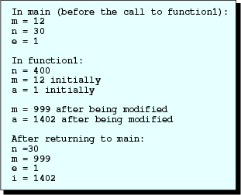
Scope
Output

Slide 45
Scope
Scope : region in which a declaration is active
four kinds of scope: block, function, file, and prototype
Scope for an identifier is determined by the location of the identifier’s declaration
  n declared in function1 has no relation to the n in main because its scope is only within function1
  m has file scope because it was declared outside any function (not recommended )
Good modular programming style has values passing to functions through the parameter lists

Slide 46
Scope
Parameters given names in function prototypes have function prototype scope
outside a one-line function prototype, the identifier is not considered to be declared
preprocessing directives e.g. #define have file scope
global variables : variables with file scope
local variables : variables with function scope

Slide 47
Mechanics of Passing Values to Functions
When a function is called, C allocates space within memory for the local variables in the function
Then C copies values of the expressions in the function call into the corresponding parameters of the function
after the execution of called function, memory space allocated to the variables is freed up i.e. destroyed
If we choose to call function1 a second time, then the memory will be reserved again (thus variables reborn again!)

Slide 48
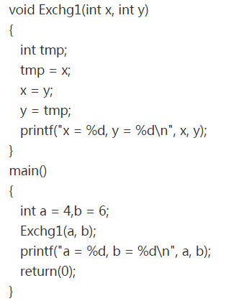


Slide 49
数组作函数参数
(1) 一维数组元素作函数参数
【ex.5】求5个数中的最小值。
int min(int x, int y)
{ return (x<y?x:y);
}
int main( )
{ int a[5],i,m ;
for (i=0; i<5; i++)
scanf("%d",&a[i]);
m=a[0];
for (i=1; i<5; i++)
m=min(m,a[i]);
printf("%d\n", m); return 0;
}
用打擂台方法求最小值。m相当于擂主

Slide 50
(2) 一维数组名作函数参数
  数组名表示数组在内存中的起始地址。
  例如:数组a在内存中从2000地址开始存放,则a的值为2000。2000是地址值，是指针类型的数据，不能把它看成是整型或其他类型数据。
  实参是数组名，形参也应定义为数组形式，形参数组的长度可以省略，但[ ]不能省，否则就不是数组形式了。
  【ex.6】用冒泡法将10个整数排序。
Notes:
解释：
“值传递”的含义是，在调用函数时，将实参变量的值取出来，复制给形参变量，使形参变量在数值上与实参变量相等。在函数内部使用从实参中复制来的值进行处理。
Ｃ语言中的实参可以是一个表达式，调用时先计算表达式的值，再将结果（值）复制到形参变量中，一旦函数执行完毕，这些存储单元所保存的值不再保留。
形式参数是函数的局部变量，仅在函数内部才有意义。
函数间形参变量与实参变量的值的传递过程类似于日常生活中的“复印”操作。

Slide 51
void sort(int b[ ],int n);
void printarr(int b[ ]);
int main( )
{ int a[10] = {11,22,63,97,58,80,45, 32,73,36};
printf("Before sort:\n");
printarr(a);
sort(a,10);
printf("After sort:\n");
printarr(a);
return 0;
}
void printarr(int b[10])
{ int i;
for (i=0; i<10; i++)
printf("%5d",b[i]);
printf("\n");
}
void sort(int b[ ], int n)
{ int i,j,t;
for (i=1; i<n; i++)
for (j=0; j<n-i; j++ )
if (b[j]>b[j+1]) { t=b[j];b[j]=b[j+1];b[j+1]=t; }
}

Slide 52
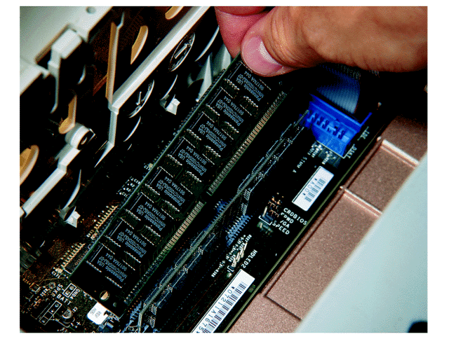
Introduction
address
内存 Random Access Memory
地址 Address
0001
0002
0003
1023
10011001
11001010
10001100
00001011
11001010
10001100
计算机内的存储部件，所有指令和数据都保存在内存中
速度快，但是掉电即失
可以随机访问
  只要指名要访问的内存单元的地址，就可以立即访问到该单元
  地址是一个无符号整数，其字长一般与主机相同
  内存中的每个字节都有唯一的一个地址
  地址按字节编号，空间按类型分配

Slide 53

Variables
&
Address
Memory：
int a=0; a
0x0037b000
Contents
Contents
Contents
Contents
Contents
变量名
Contents
Contents
Contents
Contents
Contents
Contents
0
变量的值
变量的地址

Slide 54
变量p中存放变量a的首地址
How to store the address?
0x0037b003
变量p
0x0037b003
变量a
A pointer(指针) is a variable that contains the address of another variable.

Slide 55
the pointer of a variable
& the pointer variable
指针变量p
指向 变量地址存入
指针变量
变量a
变量a的地址
变量a的值

Slide 56
Introduction
a value
Memory allocation
a address
4 bytes
10
a
int a=10,c=5;
float b=3.5;
1000
1004
3.5
b
c
1008
5
a address
a --is int variable，store value
i --is pointer, store address
1023
1000
i
pointer
address=pointer
Notes:
你借我的书，不知到哪里取，博士楼330有我的研究生，得到的信息是中教926。330是地址，其中存放了926， 926也是地址，其中有书。称926为指针，330为指针变量。
指针有正负吗？指针的长度与硬件相关吗？

Slide 57
Short summary of Pointer
Pointer variables, simply called pointers
Holding memory addresses as their values
A kind of data type
  Normally, a variable contains a specific value, e.g., an integer, a floating-point value
  However, a pointer contains the memory address of a variable that in turn contains a specific value.

Slide 58

Swap two integers’ value
pointer as arguments
code 1
code 2
main()
{
int a, b;
a = 15;
b = 8;
Swap(a, b);
printf("a=%d,b=%d",a,b);
}
main()
{
int a, b;
a = 15;
b = 8;
Swap( &a, &b );
printf("a=%d,b=%d",a,b);
}
主调函数
实 参
void Swap(int x,int y)
{
int temp;
temp = x;
x = y;
y = temp;
}
void Swap(int *x,int *y)
{
int temp;
temp = *x;
*x = *y;
*y = temp;
}
被调
函数
形 参
结果有何不同？

Slide 59
程序 1
主调函数
实 参
形 参
被调函数
void main()
{
int a, b;
a = 15;
b = 8;
Swap(a, b);
printf("a=%d,b=%d",a,b);
}
void Swap(int x, int y)
{
int temp;
temp = x;
x = y;
y = temp;
}
a
b
x
y
15
8
15
8
a
b
x
y

Slide 60
简单变量作函数参数
a
b
a
b
a
b
15
8
15
8
15
8
main
函数
Swap
函数
②
x
y
x
y
x
y
15
8
8
15
8
15
①
③
temp
temp
15
temp
15
a) 调用Swap函数
b)执行Swap函数
c) 从Swap函数返回

Slide 61
程序 2
主调函数
实 参
形 参
被调函数
void main()
{
int a, b;
a = 15;
b = 8;
Swap(&a, &b);
printf("a=%d,b=%d",a,b);
}
void Swap(int *x, int *y)
{
int temp;
temp = *x;
*x = *y;
*y = temp;
}
a
b
15
8
x
y
&a
&b
&a
&b
a
b
x
y

Slide 62
指针变量作函数参数
a
b
a
b
main
函数
②
&a
15
*x
&b
8
*y
*x
8
15
*y
①
③
Swap
函数
x
&a
&b
y
x
&a
&b
y
temp
temp
15
(a) 调用Swap函数
(b) 执行Swap函数

Slide 63
void main (void)
{
int i=5, j=6, k;
double x=10.6, y=22.3, z;
printf (" i = %d \n\r j = %d \n\r x = %f \n\r y = %f \n\n",
i, j, x, y);
function1 (i, j, x, y, &k, &z);
printf (" k = %d \n\r z = %lf \n\n", k, z);
}
void function1 (int a, int b, double r, double s, int *c, double *t)
{
*c = a + b;
*t = r + s + (*c);
printf ("*c = %d \n\r*t = %lf \n\n", *c, *t);
}

Slide 64
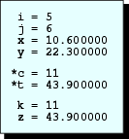
Functions that “Return” More Than
One Value
values of *c and *t (11 and 32.9) in function1 transferred to k and z in main
During function call, symbol & in front of a variable specify that the variable will receive a value from the called function
In a function prototype and function definition, use symbol * as the first symbol in a variable name whose value we want to “return” to the calling function
Output

Slide 65
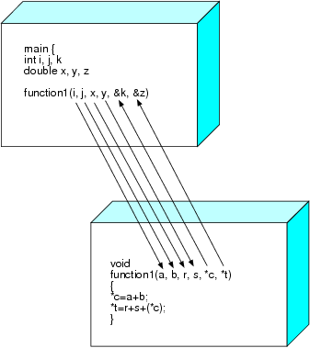
Functions that “Return” More Than
One Value
Within the body of a function, how do we handle the variables that begin with * ?
  Handle them just like you would handle any other variables e.g. () optional
  *t = r + s + (*c);
() used just to avoid confusion with multiplication operator
This method is called “call by reference”

Slide 66
Addresses and Pointer Variables
void main (void)
{
int i=5, j=6, k;
double x=10.6, y=22.3, z;
printf (“i = %d \n\r j = %d \n\r x = %lf \n\r y = %lf \n\n",
i, j, x, y);
function1 (i, j, x, y, &k, &z);
printf(“k = %d \n\r z = %lf \n\n", k, z);
printf(“Address of k = %p\n\r Address of z = %p \n“,&k, &z);
}
void function1 (int a, int b, double r, double s, int *c, double *t)
{
*c = a + b;
*t = r + s + (*c);
printf (" *c = %d \n\r *t = %lf \n\n", *c, *t );
printf (" Value contained in c = %p\n\
\r Value contained in t = %p\n\n", c, t);
}

Slide 67
Addresses and Pointer Variables
Output

Slide 68
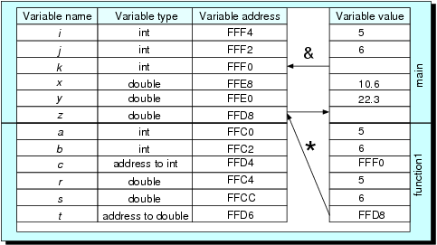
Addresses and Pointer Variables
C conceptually creates a table of all of the variables in a function
C knows how much memory space to be reserved by looking at number and type of variables declared
Variables in memory

Slide 69
Addresses and Pointer Variables
“address of” operator (&) was used to retrieve the address of a variable
variables c and t are known as pointer variables
declaration int *c indicates c will store address of int, and double *t indicates t will store address of double
unary operator * (indirection operator) causes the action of going to the address and store/read value
* appears both in
  declarator specifier : indicating that an address is to be stored in a variable’s memory cell
  void function1 (int a, int b, double r,double s,int *c,double *t)
  Unary operator: indicating to go to the address
  *c = a + b; // store a value into c pointing at
  *t = r+s+(*c); // read a value from c pointing at
not confuse one application with another

Slide 70
Addresses and Pointer Variables
conversion specification %p prints an address in a notation
hexadecimal output is expected (each represent 4 bits)
it is possible to use a calling parameter as both an input and output parameter
scanf ("%d", &k);
pass to scanf function the address of variable k
Thus scanf can inserts the value read from keyboard into the memory cell with that address

Slide 71
Recursion
Recursive functions
  Functions that call themselves
  Can only solve a base case
  Divide a problem up into
    What it can do
    What it cannot do
      What it cannot do resembles original problem
      The function launches a new copy of itself (recursion step) to solve what it cannot do
  Eventually base case gets solved
    Gets plugged in, works its way up and solves whole problem

Slide 72
Recursion
Example: factorials
  5! = 5 * 4 * 3 * 2 * 1
  Notice that
    5! = 5 * 4!
    4! = 4 * 3! ...
  Can compute factorials recursively
  Solve base case (1! = 0! = 1) then plug in
    2! = 2 * 1! = 2 * 1 = 2;
    3! = 3 * 2! = 3 * 2 = 6;

Slide 73
Recursion
#include <stdio.h>
main ( )
{ int n, p;
printf ("N=?"); scanf ("%d", &n);
p = facto (n); printf ("%d!=%d\n", n, p);
}
facto ( int n )
{ int r;
if ( n == 1 )
r = 1;
else
r = n * facto(n-1); /* recursion call */
return (r);
}

Slide 74
main first call second third fourth
n=4
p=facto(4)
call└─→ n=4
r=4*facto(3)
call└─→ n=3
r=3*facto(2)
call└─→ n=2
r=2*facto(1)
call└─→ n=1
return(1)
┌←────┘ r=2* 1 = 2 return
return(2)
┌ ← ─────┘
r=3* 2 = 6 return
return(6)
┌←─────┘
r=4* 6 = 24 return
return(24)
┌←─────┘
p= 24 return
print 24
facto ( n )
int n;
{ int r;
if (n==1)
r = 1;
else
r=n*facto(n-1);
return (r);
}
Recursion call
Recursion return

Slide 75
facto(int n)
{ int s;
if(n= =1)
s = 1;
else
{ s=facto(n-1);
s=n*s;
}
return(s);
}
facto(int n)
{ int s;
if(n= =1)
s = 1;
else
{ s=facto(n-1);
s=n*s;
}
return(s);
}
facto(int n)
{ int s;
if(n= =1)
s = 1;
else
{ s=facto(n-1);
s=n*s;
}
return(s);
}
facto(int n)
{ int s;
if(n= =1)
s = 1;
else
{ s=facto(n-1);
s=n*s;
}
return(s);
}
N=4
N=3
N=2
N=1
facto(int n)
facto(int n)
facto(int n)
facto(int n)
1
int s;
2
3
4
int s;
int s;
int s;
if(n= =1)
if(n= =1)
if(n= =1)
if(n= =1)
s = 1
s=facto(n-1)
s=facto(n-1)
s=facto(n-1)
s=n*s=4*6
s=n*s=3*2
s=n*s=2*1
1
3
2
return(24)
return(6)
return(2)
return(1)

Slide 76
Recursion
#include <stdio.h>
main ( )
{ int n, p;
printf ("N=?"); scanf ("%d", &n);
p = facto (n); printf ("%d!=%d\n", n, p);
}
facto ( int n )
{ int r;
if ( n == 1 )
r = 1;
else
r = n * facto(n-1); /* recursion call */
return (r);
}

Slide 77
Example Using Recursion: The Fibonacci Series
Fibonacci series: 0, 1, 1, 2, 3, 5, 8...
  Each number is the sum of the previous two
  Can be solved recursively:
    fib( n ) = fib( n - 1 ) + fib( n – 2 )
  Code for the fibaonacci function
    long fibonacci( long n )
    {
    if (n == 0 || n == 1) // base case
    return n;
    else
    return fibonacci( n - 1) +
    fibonacci( n – 2 );
    }

Slide 78
Example Using Recursion: The Fibonacci Series
Set of recursive calls to function fibonacci
f( 3 )
return
f( 2 )
+
f( 1 )
return
f( 1 )
+
f( 0 )
return 1
return 1
return 0

Slide 79
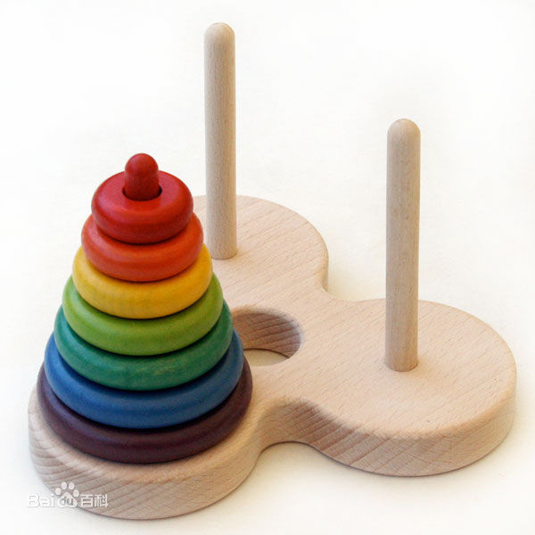
Example Using Recursion: The Hanoi Tower
：Hanoi（汉诺塔）问题。
  将 n个盘子从一根木桩移到另一根木桩上
  问题分解为：
    将 n-1个盘子从一根木桩上移到另一根木桩上
    将1个盘子从一根木桩移到另一根木桩上
  设计一个函数，入口参数为n ：
    将 n个盘子从一根木桩移到另一根木桩上
  将 n-1个盘子从一根木桩上移到另一根木桩上
    也要调用这个函数来实现
    出现了函数调用自己的问题
      递归调用（Recursive Call）

Slide 80
8.6 函数的递归调用
#include <stdio.h>
void main()
{ void hanoi(int n,char one,char two,char three);/*hanoi函数的声明*/
int m;
printf(“input the number of diskes:”);
scanf(“%d”,&m);
printf(“The step to moveing %d diskes:\n”,m);
hanoi(m,‘A’,‘B’,‘C’);
}
void hanoi(int n,char one,char two,char three)
/*定义hanoi函数，将n个盘从one座借助two座，移到three座 */
{ void move(char x,char y); /*对move函数的声明*/
if (n==1) move(one,three);
else
{ hanoi(n-1,one,three,two);
move(one,three);
hanoi(n-1,two,one,three); }
}
void move(char x,char y) /*定义move函数*/
{
printf(“%c-->%c\n",x,y);
}
例8.9：Hanoi（汉诺塔）问题。
运行结果：
input the number of diskes:3↙
The steps to noving 3 diskes:
Ａ－－＞Ｃ
Ａ－－＞Ｂ
Ｃ－－＞Ｂ
Ａ－－＞Ｃ
Ｂ－－＞Ａ
Ｂ－－＞Ｃ
Ａ－－＞Ｃ

Slide 81
Recursion vs. Iteration
Repetition
  Iteration: explicit loop
  Recursion: repeated function calls
Termination
  Iteration: loop condition fails
  Recursion: base case recognized
Both can have infinite loops
Balance
  Choice between performance (iteration) and good software engineering (recursion)

Slide 82
Thank you!
Q & A

